Slide 1
SysEng 5211 Computational Intelligence
Steven Corns
Evolutionary Computation

Slide 2
Evolutionary Computation
Mimics natural selection
Solutions represented as chromosomes
Best solutions are kept and bad ones are disposed of

Slide 3
Evolutionary Computation
Based on a genotype (informational) to phenotype (behavioral) relationship
There is a mapping from the problem space to the problem representation

Slide 4
Evolutionary Computation
Potential solutions are represented within code
Population
The algorithm manipulates the code to come up with new solutions
Operators

Slide 5
Evolutionary Computation
A pool of solutions is created at random (population)
Solutions in this population are selected
The solutions are mixed to generate new solutions

Slide 6
EC Operators
Two operators are common:
Crossover – mixes ‘genetic material’ between the two chromosomes (GA)
Mutation – random change made to the chromosome (EA)

Slide 7
One-max Problem - Crossover
100101
101011
111101
001001

Slide 8
One-max Problem - Children
100101
001001
= 5
111101
101011
= 9

Slide 9
Genetic Algorithms
One of the first techniques introduced
Uses only binary strings and crossover operator
Allows for evaluation of possible solutions and likelihood of convergence
Schema theory

Slide 10
One-max Problem - Mutation
100101
001001
= 5
= 9
111101
101011
= 10
1101111

Slide 11
Evolutionary Algorithms
An ‘Agglomeration’ of several similar techniques
Genetic Algorithms - Holland
Evolution Strategies – Rechenberg and Schwefel
Evolutionary Programming - Fogel
Genetic Programming - Whitney

Slide 12
Evolutionary Strategies/ Evolutionary Programming
Developed essentially at the same time
Focuses on mutation of solutions to find new solutions
Best parents (μ) are mutated to produce children (λ)

Slide 13
How do we pick parents?
Selection pressure
For natural selection to work, only the most fit are kept
This is based on how ‘fit’ the parents are

Slide 14
One-max Problem - Children
100101
001001
= 5
111101
101011
= 9

Slide 15
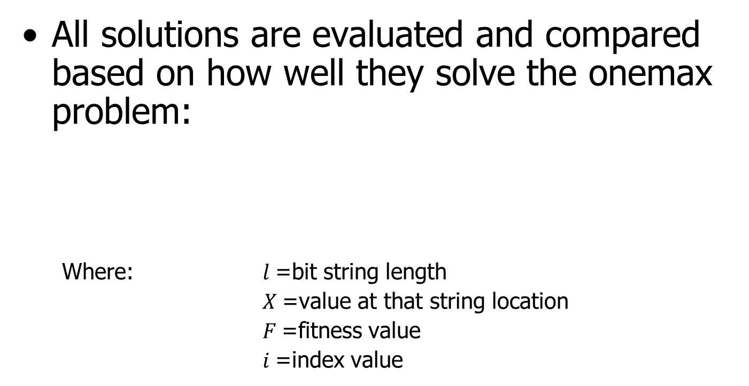

Fitness Function
All solutions are evaluated and compared based on how well they solve the onemax problem:
Where: $l$=bit string length
$X$=value at that string location
$F$=fitness value
$i$=index value
$$F=\sum_{i=0}^{l}{X_{i}}$$

Slide 16
Fitness Function
The fitness function is the driver of your algorithm
How the fitness function is created greatly affects the quality of the solution found

Slide 17
Convergence Criteria
What is an acceptable solution?
Also referred to as a stopping criteria
All depends on the goal of the algorithm

Slide 18
Selection pressure
Solutions are selected for reproduction based on their fitness:
Rank based selection
Tournament selection
Fitness proportional selection

Slide 19
Selection pressure
Can be strong or weak
Strong – the best solutions will always be used
Weak – there is a non-zero probability that weaker solutions will be selected for mating

Slide 20
Generational vs. Steady State
Generational
All population members are involved in mating
Steady state
One pair of population members is mated at a time

Slide 21
Evolutionary Algorithms in a nutshell
Create a fitness function
Decide on parameters
Create a population
Run algorithm to find a solution

Slide 22
Evolutionary Algorithms in a nutshell
Create a fitness function
Decide on parameters
Create a population
Run algorithm to find a solution

Slide 23
Evolutionary Algorithms pseudocode
Create population
While convergence criteria not met
Select population member(s)
Perform crossover
Perform mutation on children
Evaluate fitness
Apply inheritance
Report results

Slide 24
What about Genetic Programming?
Very similar to other representation
Chromosomes are made up of registers
Think ‘calculator buttons’

Slide 25
What about Genetic Programming?
+
Chromosomes make up tree like structures (LISP notation)
Are evaluated as numerical functions
*
^
+
3
/
X
*
Z
X
Z
X
Y

Slide 26
What about Genetic Programming?
+
Crossover operator acts on trees rather than the linear algorithm
*
^
+
3
/
X
*
Z
X
Z
X
Y

Slide 27
What about Genetic Programming?
+
Crossover operator acts on trees rather than the linear algorithm
Can result in bloat
Bloat can be addressed with chop operators
/
^
*
X
X
Z
+
3
*
Z
X
Y

Slide 28
Operator Disruption
Crossover and chop operators can greatly change the quality of the child
Usually this is for the worst
Sometimes this can be addressed using tools such as solution space transformations
Gray coding – successive numerical values differ only by one bit

Slide 29
Diversity in Evolutionary Algorithms
Balance of exploration and exploitation
Necessary to solve difficult problems or to achieve multiple good solutions
Initially dictated by population size

Slide 30
Controlling Diversity
Tabu list
Niching
Mating restrictions

Slide 31
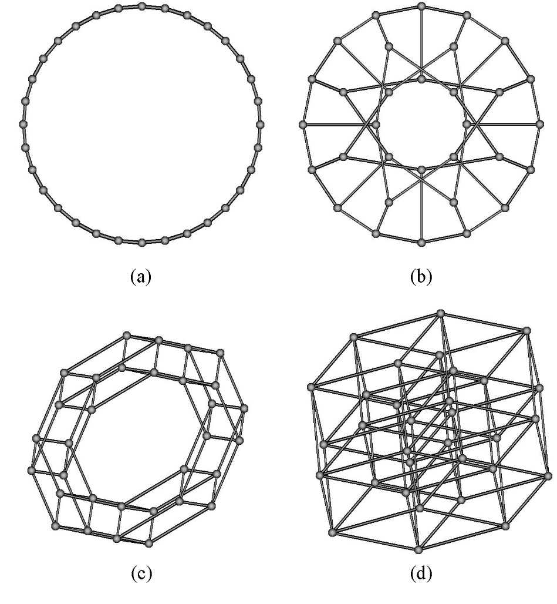
Graph Based Evolutionary Algorithms
Imposes a population structure on the algorithm being used.

Slide 32
Graphs Used
Graph | Degree | Diameter | Abbreviation
Cycle | 2 | 256 | C512
Hypercube | 9 | 9 | H9
Complete | 511 | 1 | K512
Petersen-1 | 3 | 129 | P256_1
Petersen-17 | 3 | 18 | P256_17
Petersen-3 | 3 | 46 | P256_3
Petersen-7 | 3 | 22 | P256_7
16 x 32 Toroid | 4 | 24 | T16_32
4 x 128 Toroid | 4 | 66 | T4_128
8 x 64 Toroid | 4 | 36 | T8_64
Simplexified | 4 | 19 | Z

Slide 33
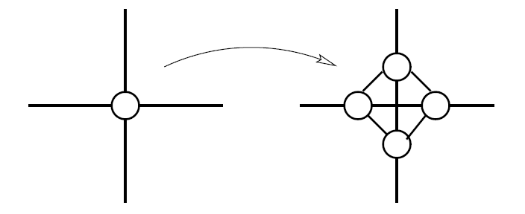
Simplexified Graph
Each vertex expanded into four
Fractal in nature, creating loosely connected groupings of more tightly connected vertices.

Slide 34
Graph Based Evolutionary Algorithms
Population member placed on each vertex.
Mating only takes place between member who share an edge.

Slide 35
Graph Based Evolutionary Algorithms
Sparser graphs perform better with difficult problems.
Thought to be due to diversity preservation but has not been verified.

Slide 36
Experimental Examples
Real-valued Sinusoidal Function
Plus-One-Recall-Store (PORS) problem

Slide 37
Real-Valued Sinusoidal Problem
3 to 9 dimensional (d) sine function
10^{d} distinct solutions available

Slide 38
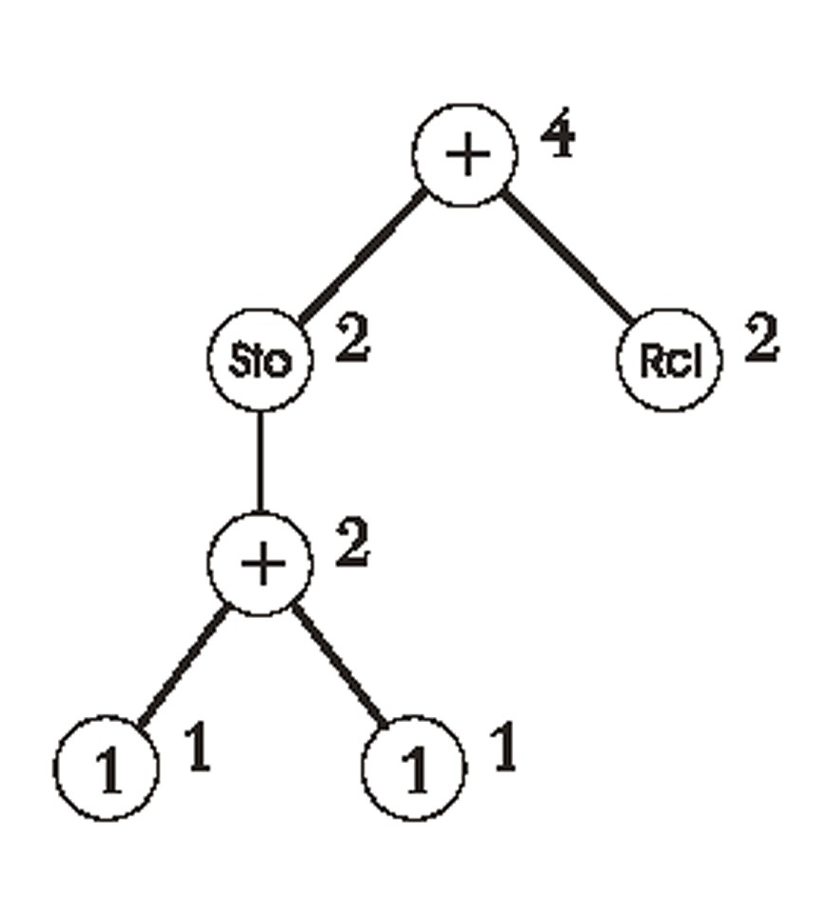
PORS Problem
Standard Genetic Programming Test Problem
6 distinct building blocks available, with 2 equivalent pairs
16 nodes used

Slide 39
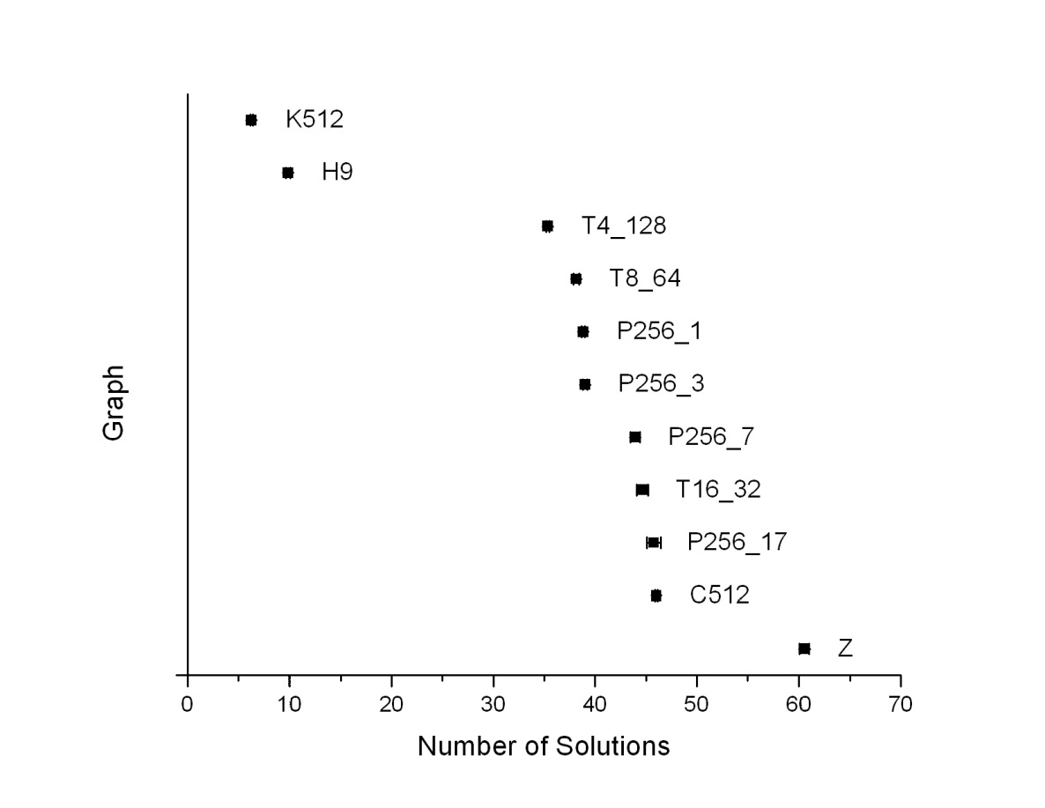
9 Dimensional Sinusoidal Function
As the number of dimensions increased, the simplexified graph continued to find more solutions.

Slide 40
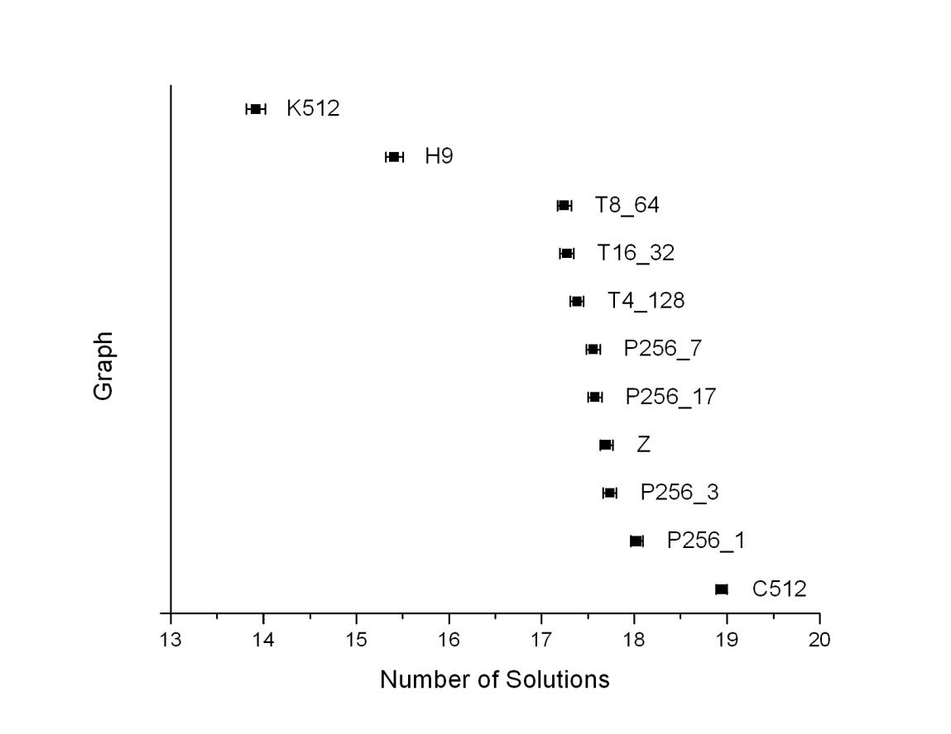
PORS16 Problem
Number of solutions found increased as graph connectivity decreased
Simplexified graph has average performance

Slide 41
Graphs for Diversity Control
Trade-off between convergence speed and diversity
When no building blocks are present, simplexified graph performs well

Slide 42
Problem representation matters
Genetic Algorithm with gray coding
Successive values differ by one bit:
Value | Binary | Gray code | Value | Binary | Gray code
0 | 0000 | 0000 | 8 | 1000 | 1100
1 | 0001 | 0001 | 9 | 1001 | 1101
2 | 0010 | 0011 | 10 | 1010 | 1111
3 | 0011 | 0010 | 11 | 1011 | 1110
4 | 0100 | 0110 | 12 | 1100 | 1010
5 | 0101 | 0111 | 13 | 1101 | 1011
6 | 0110 | 0101 | 14 | 1110 | 1001
7 | 0111 | 0100 | 15 | 1111 | 1000

Slide 43
Problem representation matters
The same problem can be solved multiple ways
This isn’t limited to just EC!
The fitness function is a major part of the representation, but there are many other factors

Slide 44
Problem representation matters
Solving an algebra problem
With d=10

Slide 45
Problem representation matters
Genetic Algorithm
Say we use a byte for each value
Chromosome is represented as a bitstring of length 80
Evaluate each byte and divide by 255 to get value of x
Issues are:

Slide 46
Problem representation matters
Real valued Evolutionary Algorithm
Say we use a byte for each value
Chromosome is represented as a numerical string of length 10
Issues are:

Slide 47
Problem representation matters
Real valued Evolutionary Algorithm
What else can we do to make it converge?
a priori knowledge
Apply transformation functions
Hybrid methods

Slide 48
Moving Forward
Next week:
Fuzzy systems
And then:
Neural networks

Slide 49
Program Completed
Missouri University of Science & Technology
© 2003 Curators of University of Missouri

